Slide 1
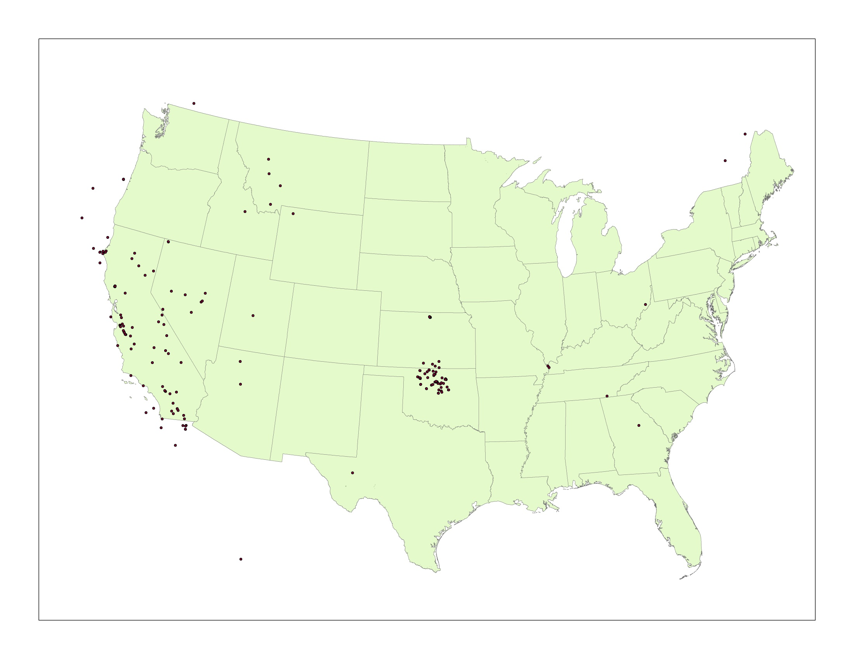
Map 1: Earthquakes in the conterminous US, March 19-April 16, 2017

Slide 2
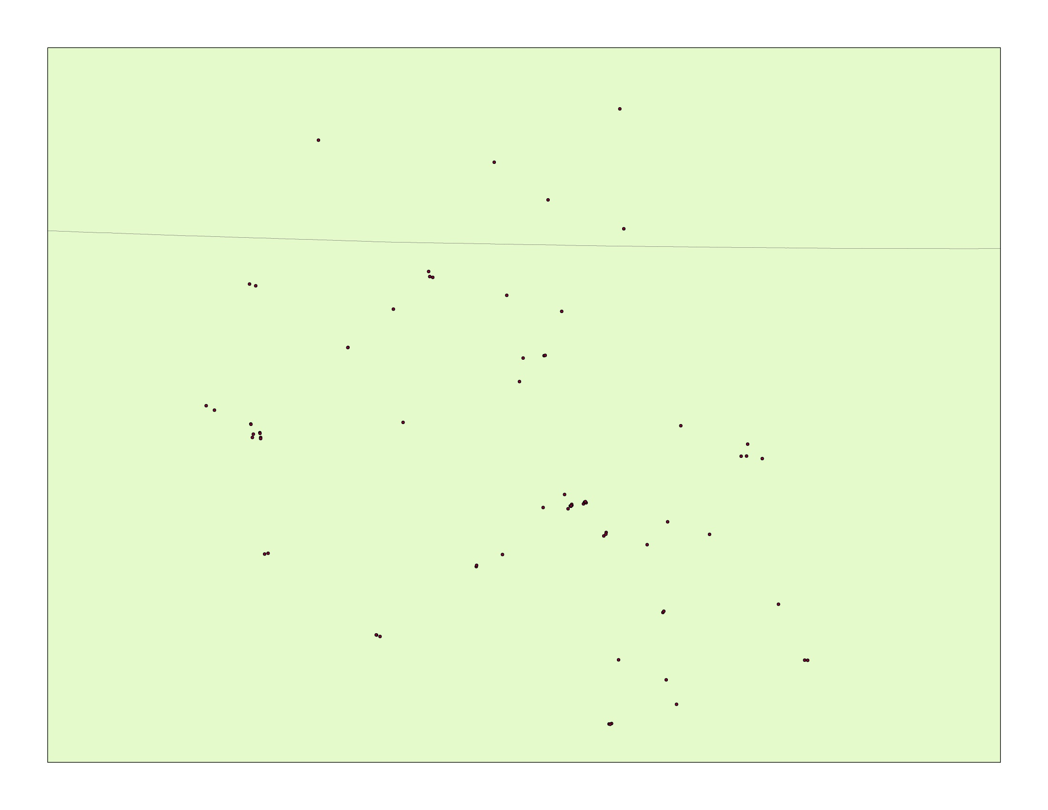
Map 2: Earthquakes in Kansas and Oklahoma, March 19-April 16, 2017

Slide 3
Map 3: Earthquakes in Kansas and Oklahoma, March 19-April 16, 2017
3
2
2
8
5
2
2
6
3
3
2
2
3

